Slide 1
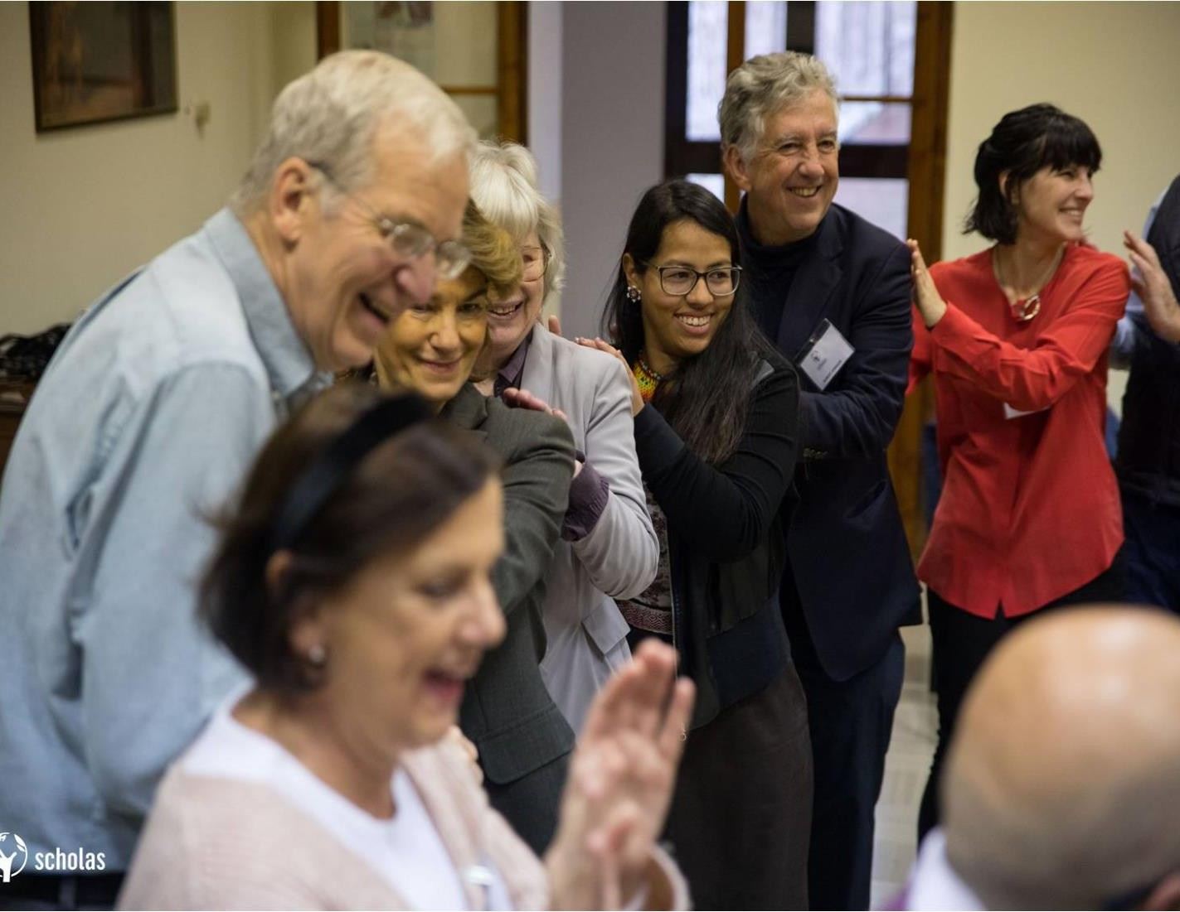


Notes:
Scholas Chairs and the University of the Meaning as expressions of the social misión of Higher Education

Slide 2
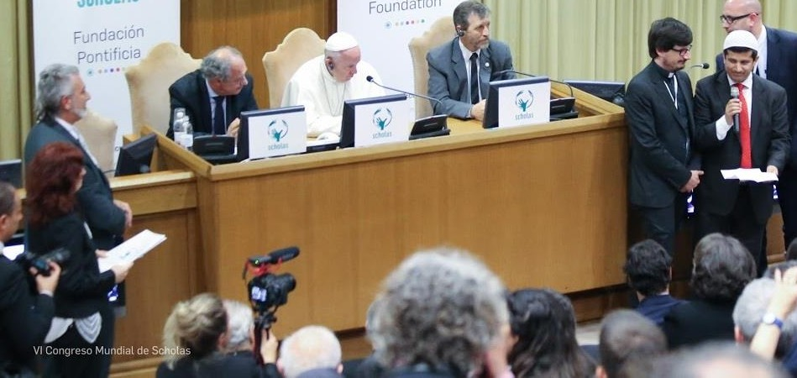
2
Notes:
What are the Scholas Chairs?
They are a “network” that intertwines universities ─public, private, secular and of different creeds─ “that go forth” and are engaged with a “real cultural revolution” based on listening the youths.

Slide 3















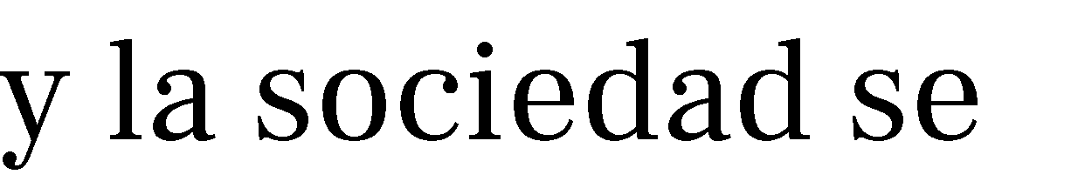
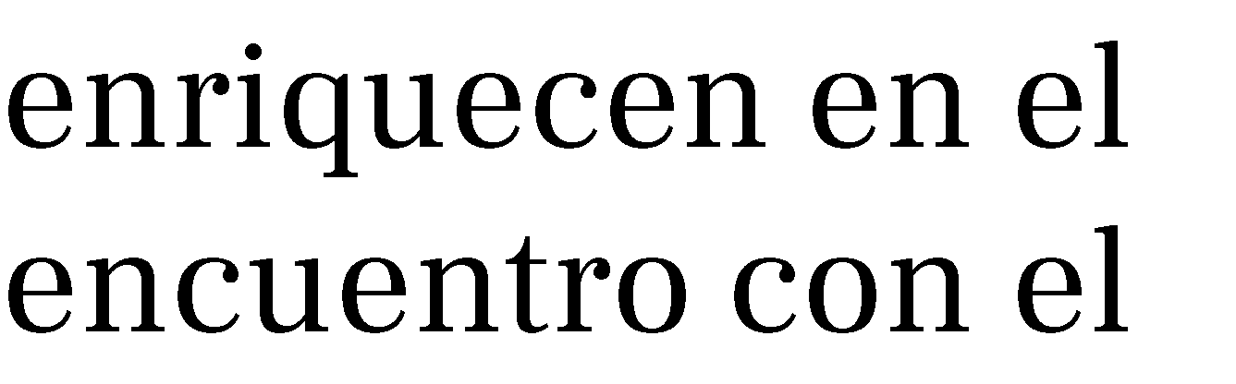

3
Notes:
What is a Scholas Chair?
A Scholas Chair is a spaces for “reflection and action” connected by a network where students professors, researchers and society are enriched by the encounter with others.

Slide 4




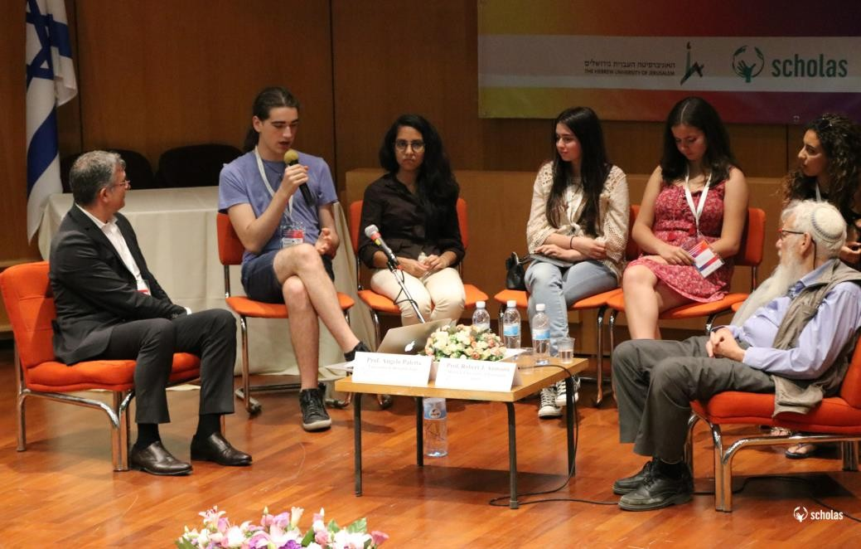
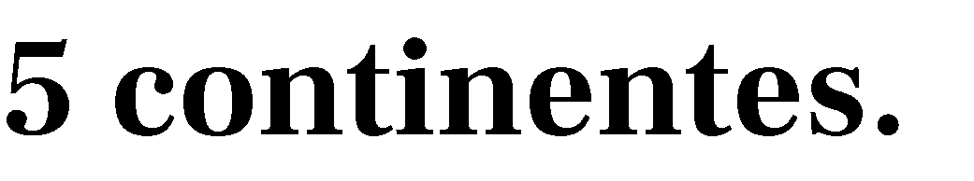




◍
◍
◍
◍
◍
◍
4
Notes:
Who are part of the network?
117 universities, 37 countries, 5 continents.
Africa: 8 universities, 6 countries.
America: 59 universities, 13 countries.
Asia: 6 universities, 5 countries.
Europe: 43 universitites, 12 countries.
Oceania: 1 university, 1countries.

Slide 5

































5
Notes:
Scholas Chairs timeline
I Congress (Vatican City, May 2016)
Executive Comitee (Rome, 13th October 2016)
II Congress (Valencia, March 2017)
III Congress (Jerusalem, July 2017)
Think tank – Academic year 2017-2018
Executive Comitee (Rome, 12th December 2017)
IV Congress (Castelgandolfo, July 2018)
Executive Comitee (Rome, 17th December 2018)
Think tank – Academic year 2018-2019
V Congress (New York, June 2019)

Slide 6







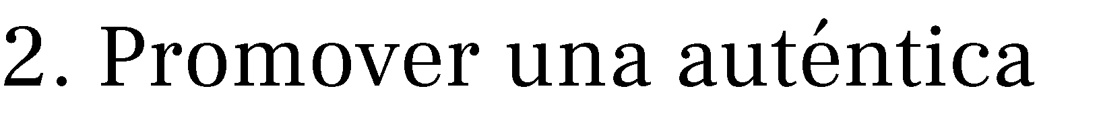

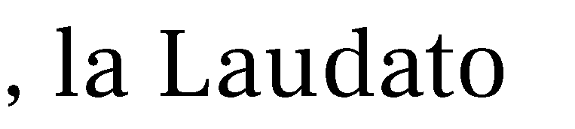

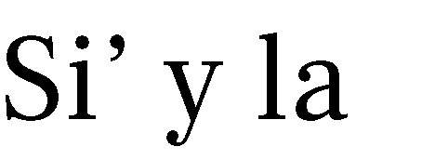

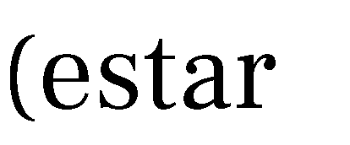
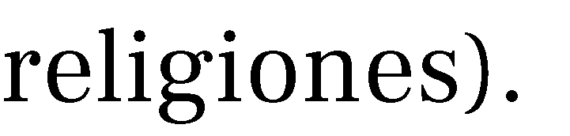



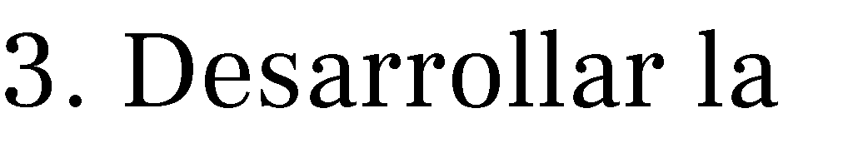


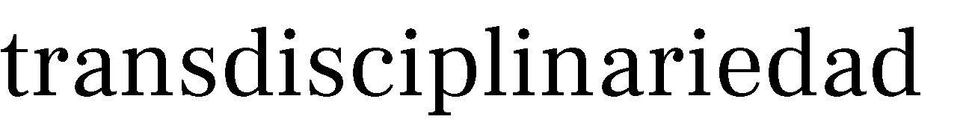




6
Notes:
Four basic criteria for the Scholas Chair development
1. Give social dimention specific shape according to the Evangelii Gaundium, Laudato Si’ and Veritatis Gaudium (be “going forth”).
2. Promote a real Culture of Encounter (with people, culture and religions).
3. Develop inter- and trans-disciplinary aspects: improve research quality to face complex problems.
4. Network develpment: cooperation logic, not competition one.

Slide 7





Cambio educativo Carencias de la educación formal Falta de espacios recreativos | 1. Educar para el Humanismo Solidario (Innovación educativa)
Suicidio juvenil Contaminación / Medio Ambiente Pobreza / Falta de oportunidades Consumo sostenible Anorexia / Bulimia / Depresión Embarazo precoz / Aborto | 2. Laudato Si’ (Ecología Integral: sostenibilidad ambiental y social)
Estereotipos / Discriminación Falta de integración social Bullying / Cyberbullying Violencia | 3. Diálogo interreligioso e intercultural para la paz sostenible
7
Notes:
What are our topics of reflection and action?
(PRIMERA COLUMNA)
Problems identified by students in the Scholas Citizenship programme
Changes in education
Lack of formal education
Lack of spaces for recreation
Youth suicide
Contamination/ Environment
Poverty / Lack of opportunities
Sustainable consumption
Anorexia / Bulimia / Depression
Early pregnancy / Abortion
Stereotyping / Discrimination
Lack of social integration
Bullying / Cyberbullying
Violence
(SEGUNDA COLUMNA)
Focus of research – action
Education for Solidarity Humanism (innovative education)
Laudato Si’ (Integral Ecology: social and environmental sustainability
Inter-religious and inter-cultural dialogue for sustainable peace.

Slide 8










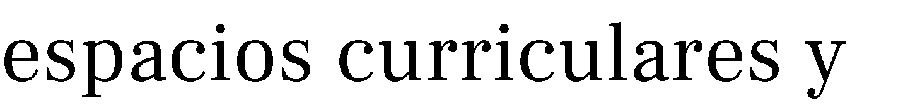
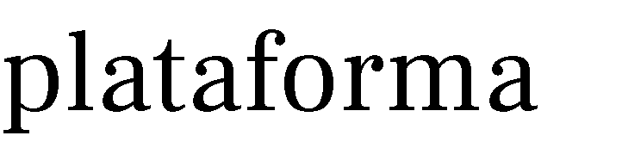











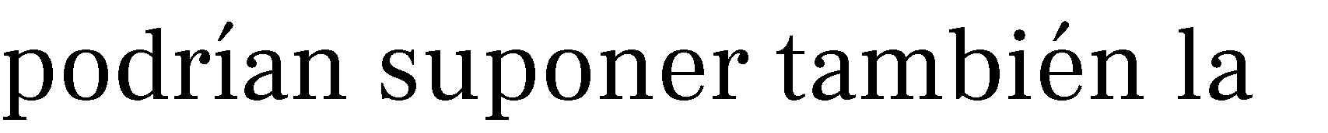




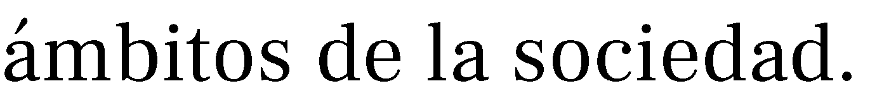
8
Notes:
Scholas Chairs Activities:
Support for educational and social projects: Scholas Chairs provide educational support and expert consulting for projects placed on Scholas. Social platform, or those communities related to them.
Didactics: Work related to the contents produced by Scholas Chairs, through active and motivating methodologies, in curricular and extracurricular spaces.
Research: Professors and students can elaborate a comprehensive research on the subject proposed by the Chairs. It could also entails the development of specific post-graduated courses.
Awareness-raising and insertion in public policies: Promoting dissemination, communication and training on the values of the Culture of Encounter in the various areas of society.

Slide 9
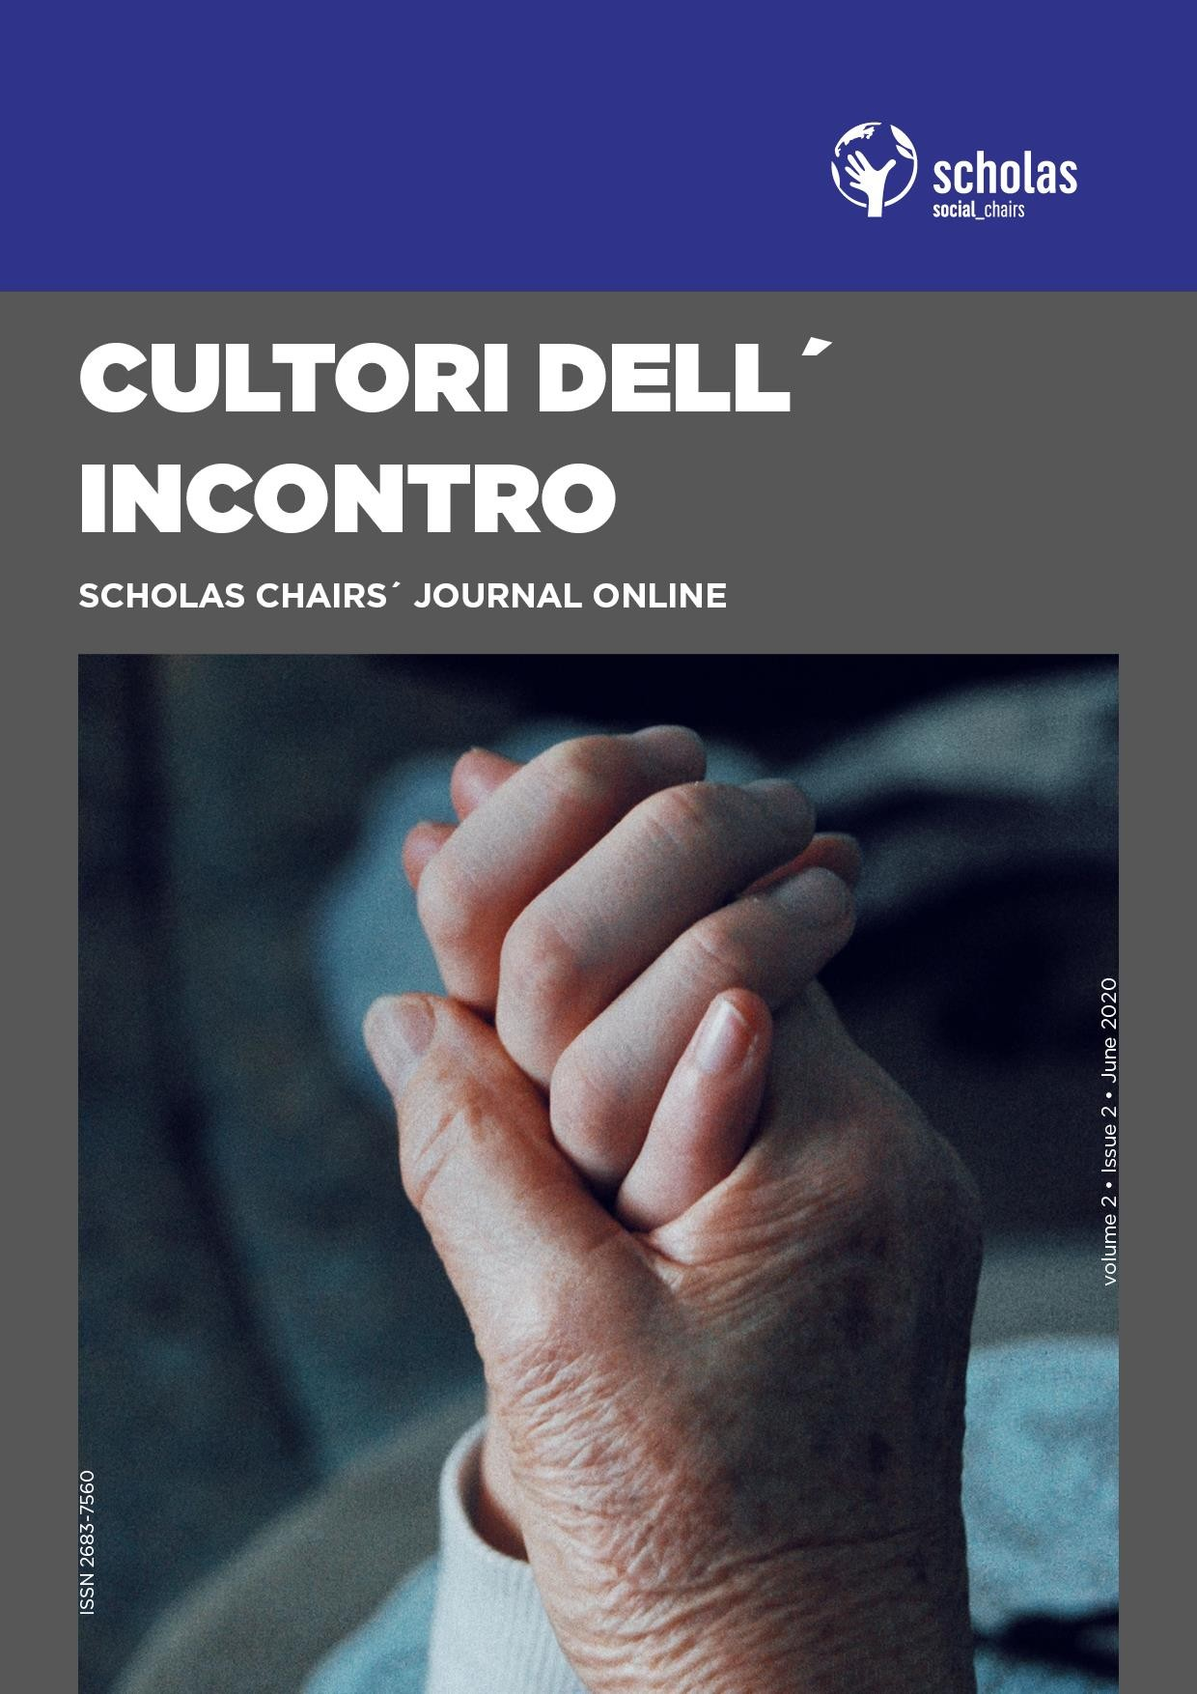






9
Notes:
Scholas Chairs’ Scientific Journal

Slide 10
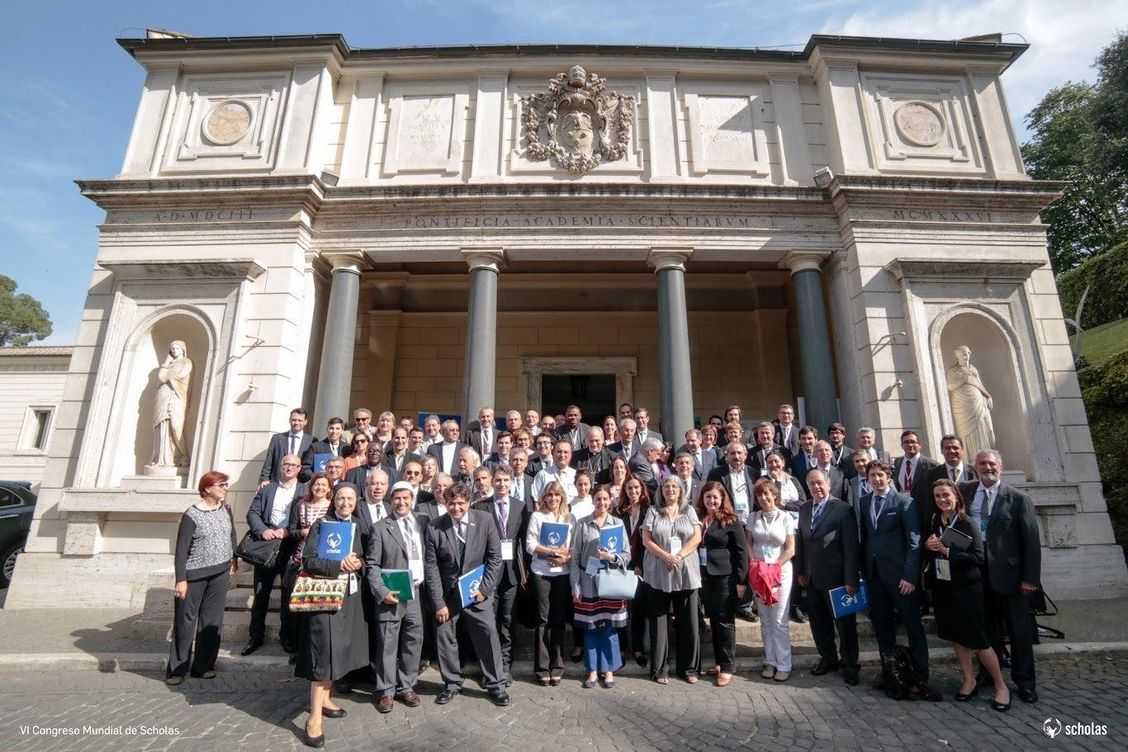

10
Notes:
What are the steps university should follow to open a Scholas Chair?
There are different ways and level of participation to develop a Scholas Chair at a university.
A Chair can be established from the initiative and engagemente of a single profesor, faculty, department, research institute or rectorate. The aim is to involve academir comunity more and more.

Slide 11

La Universidad del Sentido es una universidad pública,
gratuita, global, intergeneracional, interreligiosa y multicultural con sede formal en la Ciudad del Vaticano pero con micro sedes distribuidas en universidades confesionales, públicas y privadas de los cinco continentes.
En la UdS el centro ya no es el docente, son los estudiantes
y la sociedad, por eso se tiene en cuenta la necesidad de la sociedad entera; no tendrá carreras sino tramos de conocimiento que serán
acreditados en diferentes trayectos del diseño curricular. Por ejemplo, experiencias locales o de intercambio con estudiantes para implementar proyectos
de RSU
11
Notes:
University of Meaning
The University of Meaning is a public, free, global, inter-generational, inter-religious and multicultural university with formal headquarters in Vatican City, but with micro-headquarters distributed in religious, public and private universities on five continents.
In the University of Meaning, the focus is no longer on the professor, but on the students and society, so the need of the whole society is take into account; there are no degrees but areas of knowledge that will be accredited on different cycles of curriculum design. For example, local or student-exchange experiences to implement USR projects

Slide 12


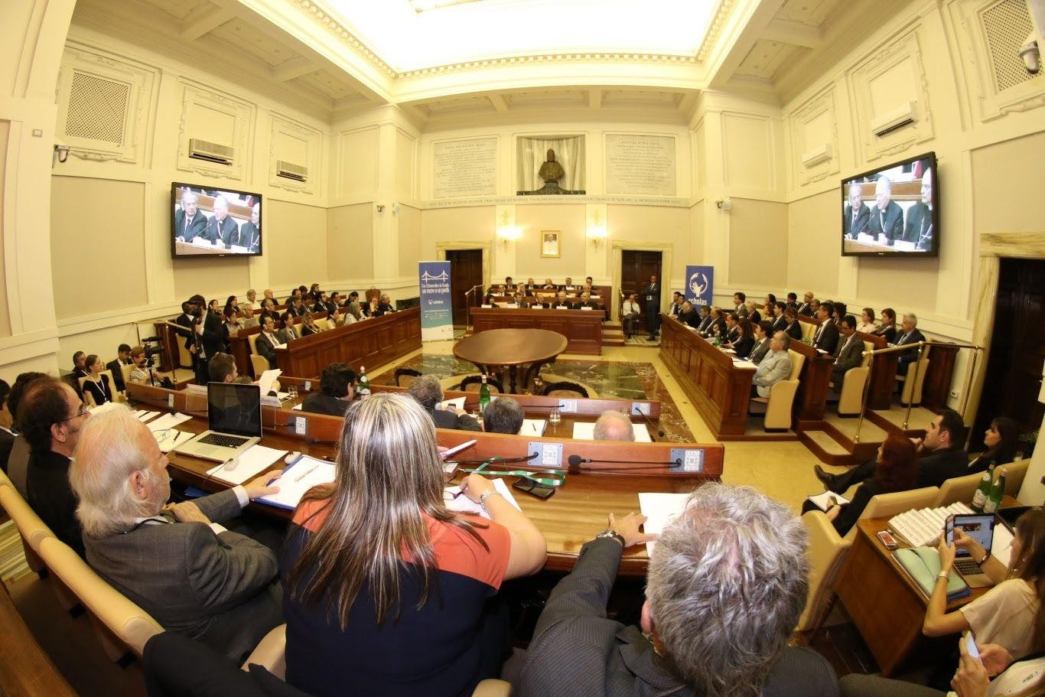

12
Notes:
Thank you!
For more information:
scholaschairs@scholasocurrentes.org

